Slide 1
Type 2 Diabetes Prediction Model
Muhammad Faisal Shahid

Slide 2
Overview
Recap
Challenges
Utilizing Provider Notes
Feature Selection
Future Directions

Slide 3
Recap
Patient Distribution
Total Patients
1,145,465
T2DM Patients
72,626
Other Patients
1,072,839
Patients with at least 3 Encounters
4,896
Other Patients
67,730
Patients with at least 3 Encounters
31,358

Slide 4
Recap
Classifiers Evaluation
Algorithm | Accuracy | Precision | Recall | F1 score | AUC
Logistic Regression | 0.876 | 0.881 | 0.868 | 0.875 | 0.876
SVM (Linear) | 0.876 | 0.878 | 0.873 | 0.875 | 0.876
Random Forest | 0.815 | 0.795 | 0.849 | 0.821 | 0.815
AdaBoost (RF) | 0.835 | 0.805 | 0.884 | 0.843 | 0.835
XGBoost | 0.782 | 0.788 | 0.772 | 0.78 | 0.782

Slide 5
Recap
Features Scaling
Normalization
MinMaxScaler
Scale down feature b/w 0 and 1
Standardization
StandardScaler
Scale down feature based on standard normal distribution

Slide 6
Challenges
Missing values in the previous Data Chunks
Outliers in the new Data Chunk
Missing identifiers in the new Data Chunk
Unavailability of dB

Slide 7
MVR Comparison
Missing Value Ratios
Vital | MVR (Before) | MVR (After)
Pulse | 96.90 | 28.76
Respiration | 96.90 | 51.41
Temperature | 96.90 | 55.23
Systolic | 93.29 | 16.53
Diastolic | 93.29 | 16.52

Slide 8
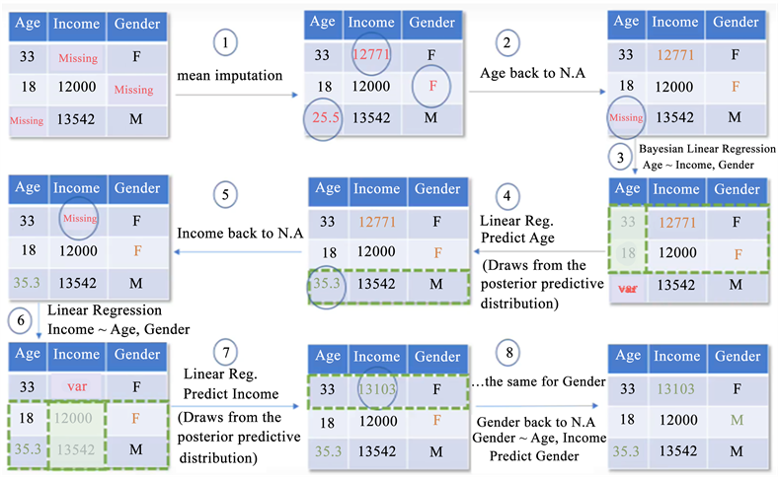
The MICE Imputation
MICE Imputation, short for ‘Multiple Imputation by Chained Equation’ is an advanced missing data imputation technique that uses multiple iterations of Machine Learning model training to predict the missing values using known values from other features in the data as predictors.

Slide 10
Utilizing Provider Notes
Vitals Extraction from Provider Notes
Total Unique Patients: 35,480
Diabetic (Type 2): 4122
Other: 31,358
Total Provider Notes: 5,74,617
Available Notes: 23,299
Patients: 3,984
Total Provider Notes: 7,72,227
Available Notes: 1,98,189
Patients: 20,119

Slide 11
Medications
Prednisone, Acarbose, Miglitol, Olanzapine, Clozapine, Stavudine, Serotonin Reuptake Inhibitors, Hydrochlorothiazide, Atenolol, Metoprolol, Doxazosin, Terazosin, Lisinopril, Enalapril, Losartan, Atorvastatin, Simvastatin, Gemfibrozil, Fenofibrate, Niacin
Causes: Glucose Metabolism, Insulin Resistance or Weight Gain

Slide 12
Procedures
Pancreatic Surgery, Cardiovascular Surgery,
Kidney Transplantation, Bariatric Surgery
Causes: Insulin Production or Glucose Metabolism

Slide 13
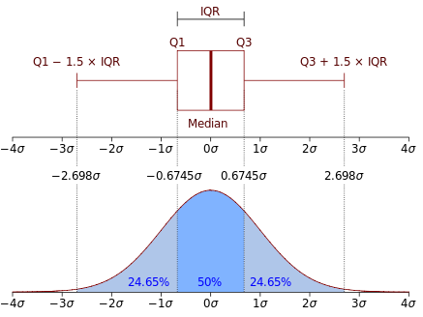
Handling Outliers
Total Patients 31,235
Diabetic: 3,785
Non Diabetic: 27,450

Slide 14
Results Comparison with Medications and Surgeries

Slide 15
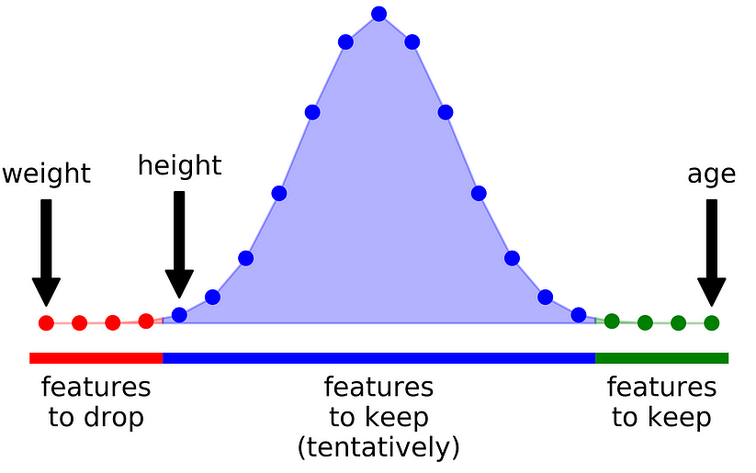
Feature Selection
Boruta
Adds randomness to the given data set by creating shuffled copies of all features (which are called shadow features).
It trains a random forest classifier on the extended data set and applies a feature importance measure.

Slide 16
Feature Selection
Mutual Information
Dependency or relation of features to its target feature
If the value is 0 then the feature and the target feature is independent to each other
Returns all features with importance

Slide 17
Feature Selection
Chi2
The chi-squared test helps you determine if there's a significant association or pattern between two categorical things.
Returns all features with importances

Slide 18
Classifiers Results Comparison
Algorithm | Accuracy (N=810) | Accuracy (N=74)
Logistic Regression | 0.889 | 0.837
SVM (Linear) | 0.865 | 0.841
Random Forest | 0.816 | 0.825
AdaBoost (RF) | 0.838 | 0.830
XGBoost | 0.798 | 0.785
N is the number of features
Clinically relevant features are retained during feature selection process

Slide 19
Summary
Dataset: Diabetic = 3,785 Non Diabetic = 27,450 and features = 64
Includes: Demographics, Vitals, Diagnosis, Medications, Procedures
Achieved Results:
Algorithm | Accuracy | Precision | Recall | F1 score | AUC | Specificity | Sensitivity | PPV | NPV | AUPR
Logistic Regression | 0.837 | 0.881 | 0.868 | 0.875 | 0.876 | 0.849 | 0.824 | 0.846 | 0.829 | 0.879
SVM (Linear) | 0.841 | 0.878 | 0.873 | 0.875 | 0.876 | 0.844 | 0.839 | 0.843 | 0.840 | 0.881
Random Forest | 0.825 | 0.795 | 0.849 | 0.821 | 0.815 | 0.808 | 0.849 | 0.816 | 0.842 | 0.870
AdaBoost (RF) | 0.830 | 0.805 | 0.884 | 0.843 | 0.835 | 0.810 | 0.849 | 0.817 | 0.843 | 0.871
N is the number of features

Slide 20
Comparison with The Henan Rural Cohort Study
The study excluded patients if they were diagnosed with kidney failure or cancer, had type 1 diabetes, had gestational diabetes, had incomplete information on diagnoses of T2DM and had incomplete information of potential covariates.
Now incorporating metrics that have been referenced in the study.
Study includes demographics, vitals, diagnosis, lab tests, family history

Slide 21
Future Directions
Accommodate Family and Social History
Feature Importance and Feature Selection
Integration with Explainable Interface
Type 1 Diabetes Prediction Model

Slide 22

Thank you!

